Slide 1
Solid Cone and Hemisphere

Slide 2


Solid Cone and Hemisphere
Not drawn to scale
$10$ cm
$4$ cm
The cone and the hemisphere have circular bases of equal radius.
A horizontal slice is made through both solid objects at the height shown.
What is the sum of the shaded areas so formed?
Repeat with another slice at a height of your choice.
Can you make a conjecture? Can you prove it?

Slide 3




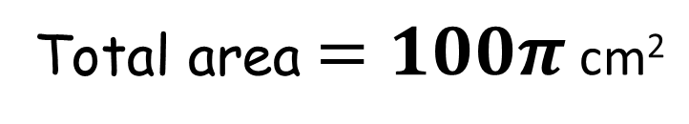

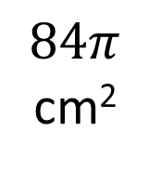

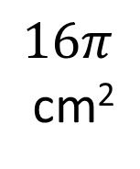
Solid Cone and Hemisphere
$10$ cm
$4$ cm
$10$ cm
$\sqrt{84}$ cm
$4$ cm
$4$ cm
$10$ cm
$16π$
cm²
$$84π$$
cm²
Total area $=100π$ cm²

Slide 4
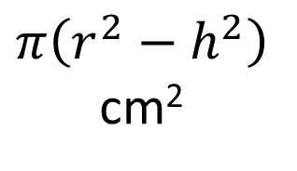

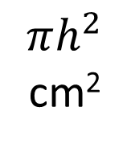






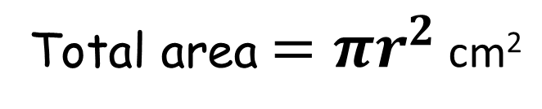
Solid Cone and Hemisphere
$r$ cm
$h$ cm
$r$ cm
$\sqrt{r^{2}−h^{2}}$ cm
$h$ cm
$h$ cm
$r$ cm
$$πh^{2}$$
cm²
$$π\left(r^{2}−h^{2}\right)$$
cm²
Total area $=πr^{2}$ cm²

Slide 5
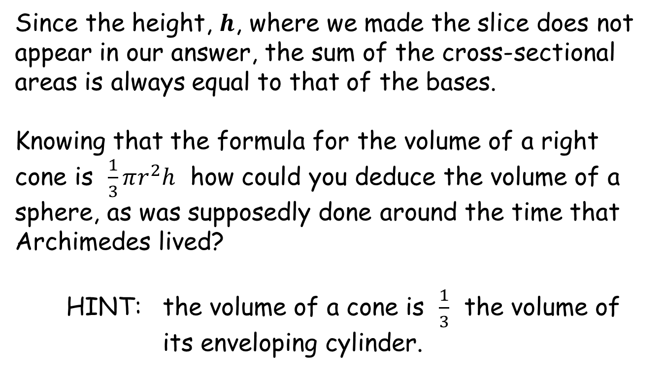
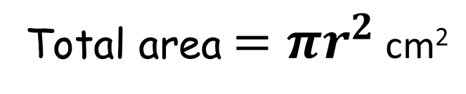
Solid Cone and Hemisphere
Total area $=πr^{2}$ cm²
Since the height, $h$, where we made the slice does not appear in our answer, the sum of the cross-sectional areas is always equal to that of the bases.
Knowing that the formula for the volume of a right cone is $\frac{1}{3}πr^{2}h$ how could you deduce the volume of a sphere, as was supposedly done around the time that Archimedes lived?
HINT: the volume of a cone is $\frac{1}{3}$ the volume of its enveloping cylinder.

Slide 6
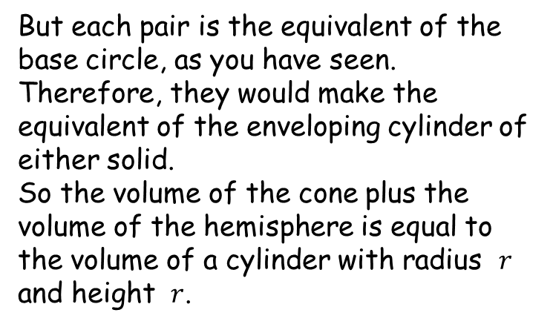
Solid Cone and Hemisphere
Imagine slicing both solids in a salami-like fashion, ending up with a large number of very thin slices.
These slices can be put back together to make the original objects.
But each pair is the equivalent of the base circle, as you have seen.
Therefore, they would make the equivalent of the enveloping cylinder of either solid.
So the volume of the cone plus the volume of the hemisphere is equal to the volume of a cylinder with radius $r$ and height $r$.

Slide 7



Solid Cone and Hemisphere
$$\frac{1}{3}πr^{3}$$
$$\frac{2}{3}πr^{3}$$
$$πr^{3}$$

Slide 9
Note to Teacher
The area is equal to the base of either object
This could be a gentle lead in to the idea of integration

Slide 11
Kept for possible future edits

Slide 12
Kept for possible future edits

Slide 13
RESOURCES

Slide 14


Solid Cone and Hemisphere
Not drawn to scale
$13$ cm
$4$ cm
The cone and the hemisphere have circular bases of equal radius.
A horizontal slice is made through both solid objects at the height shown.
What is the sum of the shaded areas so formed?
Repeat with another slice at a height of your choice.
Can you make a conjecture? Can you prove it?
SIC_85

Slide 15


Solid Cone and Hemisphere
Not drawn to scale
$11$ cm
$5$ cm
The cone and the hemisphere have circular bases of equal radius.
A horizontal slice is made through both solid objects at the height shown.
What is the sum of the shaded areas so formed?
Repeat with another slice at a height of your choice.
Can you make a conjecture? Can you prove it?
SIC_85

Slide 16

Solid Cone and Hemisphere
Not drawn to scale
$12$ cm
$4$ cm
The cone and the hemisphere have circular bases of equal radius.
A horizontal slice is made through both solid objects at the height shown.
What is the sum of the shaded areas so formed?
Repeat with another slice at a height of your choice.
Can you make a conjecture? Can you prove it?
SIC_85

Slide 17

Solid Cone and Hemisphere
Not drawn to scale
$12$ cm
$3$ cm
The cone and the hemisphere have circular bases of equal radius.
A horizontal slice is made through both solid objects at the height shown.
What is the sum of the shaded areas so formed?
Repeat with another slice at a height of your choice.
Can you make a conjecture? Can you prove it?
SIC_85

Slide 18


Solid Cone and Hemisphere
Not drawn to scale
$20$ cm
$8$ cm
The cone and the hemisphere have circular bases of equal radius.
A horizontal slice is made through both solid objects at the height shown.
What is the sum of the shaded areas so formed?
Repeat with another slice at a height of your choice.
Can you make a conjecture? Can you prove it?
SIC_85

Slide 19

Solid Cone and Hemisphere
Not drawn to scale
$20$ cm
$6$ cm
The cone and the hemisphere have circular bases of equal radius.
A horizontal slice is made through both solid objects at the height shown.
What is the sum of the shaded areas so formed?
Repeat with another slice at a height of your choice.
Can you make a conjecture? Can you prove it?
SIC_85

Slide 20


Solid Cone and Hemisphere
Not drawn to scale
$21$ cm
$9$ cm
The cone and the hemisphere have circular bases of equal radius.
A horizontal slice is made through both solid objects at the height shown.
What is the sum of the shaded areas so formed?
Repeat with another slice at a height of your choice.
Can you make a conjecture? Can you prove it?
SIC_85

Slide 21


Solid Cone and Hemisphere
Not drawn to scale
$25$ cm
$7$ cm
The cone and the hemisphere have circular bases of equal radius.
A horizontal slice is made through both solid objects at the height shown.
What is the sum of the shaded areas so formed?
Repeat with another slice at a height of your choice.
Can you make a conjecture? Can you prove it?
SIC_85

Slide 22

Solid Cone and Hemisphere
Not drawn to scale
$30$ cm
$6$ cm
The cone and the hemisphere have circular bases of equal radius.
A horizontal slice is made through both solid objects at the height shown.
What is the sum of the shaded areas so formed?
Repeat with another slice at a height of your choice.
Can you make a conjecture? Can you prove it?
SIC_85

Slide 23
Solid Cone and Hemisphere
Not drawn to scale
$30$ cm
$5$ cm
The cone and the hemisphere have circular bases of equal radius.
A horizontal slice is made through both solid objects at the height shown.
What is the sum of the shaded areas so formed?
Repeat with another slice at a height of your choice.
Can you make a conjecture? Can you prove it?
SIC_85

Slide 24
Solid Cone and Hemisphere
Not drawn to scale
$30$ cm
$8$ cm
The cone and the hemisphere have circular bases of equal radius.
A horizontal slice is made through both solid objects at the height shown.
What is the sum of the shaded areas so formed?
Repeat with another slice at a height of your choice.
Can you make a conjecture? Can you prove it?
SIC_85

Slide 25
Solid Cone and Hemisphere
Not drawn to scale
$30$ cm
$9$ cm
The cone and the hemisphere have circular bases of equal radius.
A horizontal slice is made through both solid objects at the height shown.
What is the sum of the shaded areas so formed?
Repeat with another slice at a height of your choice.
Can you make a conjecture? Can you prove it?
SIC_85

Slide 26

Solid Cone and Hemisphere
Not drawn to scale
$30$ cm
$11$ cm
The cone and the hemisphere have circular bases of equal radius.
A horizontal slice is made through both solid objects at the height shown.
What is the sum of the shaded areas so formed?
Repeat with another slice at a height of your choice.
Can you make a conjecture? Can you prove it?
SIC_85

Slide 27
Solid Cone and Hemisphere
Not drawn to scale
$30$ cm
$7$ cm
The cone and the hemisphere have circular bases of equal radius.
A horizontal slice is made through both solid objects at the height shown.
What is the sum of the shaded areas so formed?
Repeat with another slice at a height of your choice.
Can you make a conjecture? Can you prove it?
SIC_85

Slide 28

Solid Cone and Hemisphere
Not drawn to scale
$40$ cm
$9$ cm
The cone and the hemisphere have circular bases of equal radius.
A horizontal slice is made through both solid objects at the height shown.
What is the sum of the shaded areas so formed?
Repeat with another slice at a height of your choice.
Can you make a conjecture? Can you prove it?
SIC_85

Slide 29

Solid Cone and Hemisphere
Not drawn to scale
$40$ cm
$12$ cm
The cone and the hemisphere have circular bases of equal radius.
A horizontal slice is made through both solid objects at the height shown.
What is the sum of the shaded areas so formed?
Repeat with another slice at a height of your choice.
Can you make a conjecture? Can you prove it?
SIC_85

